Slide 1
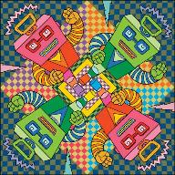
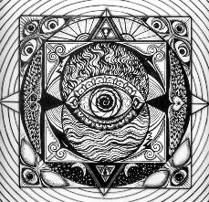
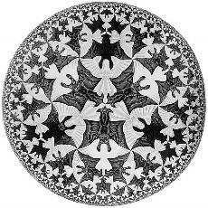
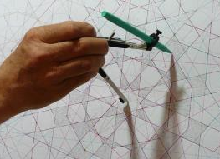
Geometry and Art
A Lesson in
Line & Balance

Slide 2
Elements of Style vs. Principles of Art
Tools in your Artist Toolbox
What you Can
Do with your Tools

Slide 3
What is a Line?
A mark that connects 2 points.
Notes:
Everyone knows what line is BUT
How is line important in art? How can it help an artist?

Slide 4
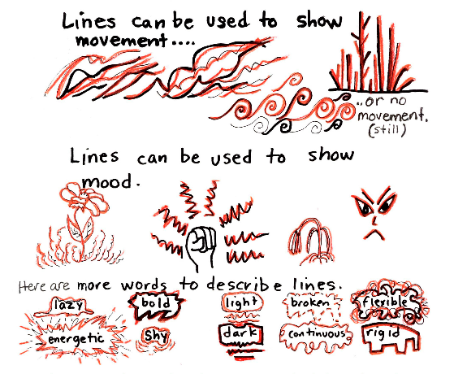
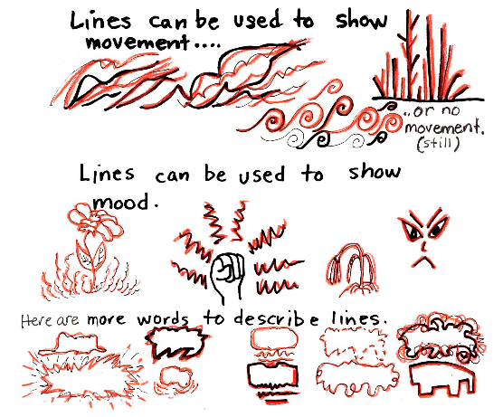
Lines can take a variety of Properties
In addition to having many properties Lines can be used to…
Lines can be…
Long/Short
Thick/Thin
Dotted or Broken
Straight/Wavy or Curved
Spiral/Tapered
Parallel/ Perpendicular
Vertical/Horizonal/Diagonal
Notes:
Ask class - What adjectives can you use to describe lines?
Besides noticing the basic properties of lines,
Artist use lines to show
Movement or Still-ness
Mood
And by connecting lines to each other Lines can create shapes that give the feeling of many other properties,

Slide 5
What is ?
The comfortable arrangement of things in art

Slide 6
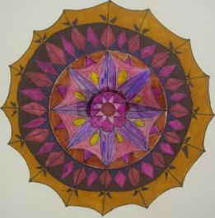
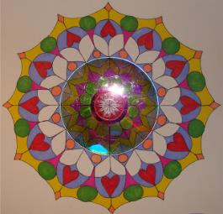
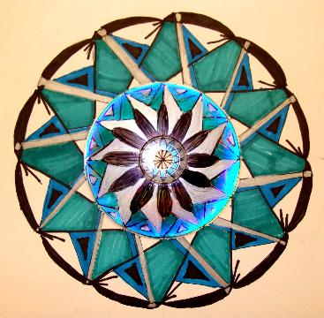
Musical Mandalas

Slide 7
Line Examples

